Slide 1
Scanflow
Scalable library for end-to-end
ML workflow management
Lenovo-BSC collaboration
January 2020

Slide 2
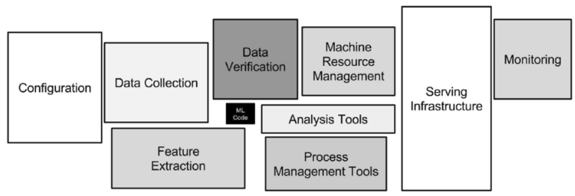
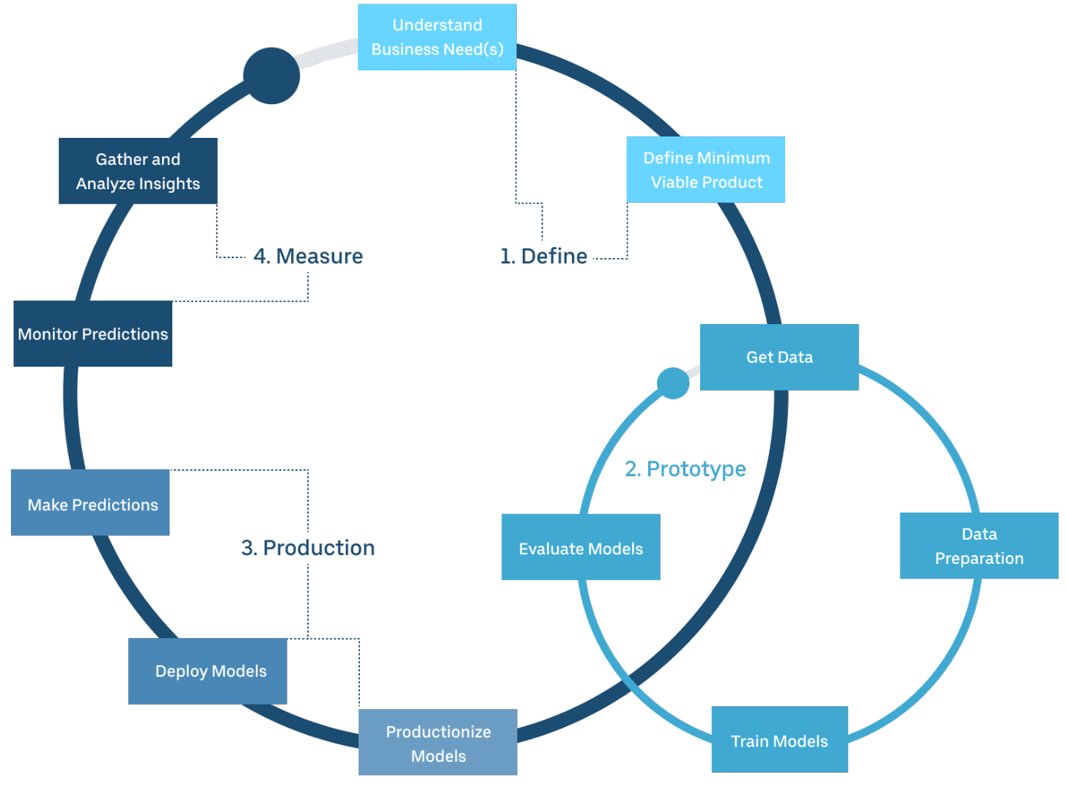
Applied Machine Learning: Workflow
Deployment: The ML code is a small part of the complete pipeline. More steps are needed to get it working on production.
Source: Sculley D., Holt. G.
The modeling phase is not the end of a workflow, more steps are needed.
Applied ML workflow: Packaging ML workflows for later use will decrease the prototyping and deployment time .
Source: Uber ML.

Slide 3
Applied Machine Learning: Issues
Moving a complete workflow from development platform to another new platform can break things, e.g, operating system, libraries, dependencies, etc.
Controlling a myriad of pipelines manually might be hard.
Some steps in a workflow need different amount and type of computational resources, e.g, RAM, Storage, CPU, GPU.
The complete workflow might scale from a single node to a cluster.
The dataset distribution might change (normal, poison, etc, or different patterns). It is called distribution drift. An anomaly detector might help this.
Some feature levels and balance of classes might change (categories, e.g, before {red, blue}, after {red, blue, black}. Classes, e.g, before {30% men, 70%women}. after {60% men, 40%women}).
Data scientists require tools for ease of deployment, tracking and reproducing experiments.
How can the agent (model) and human collaborate to solve problems?
We need Interactive Machine Learning tools
In production, many unexpected situations might arise such as drift distributions, unformatted data, etc.

Slide 4
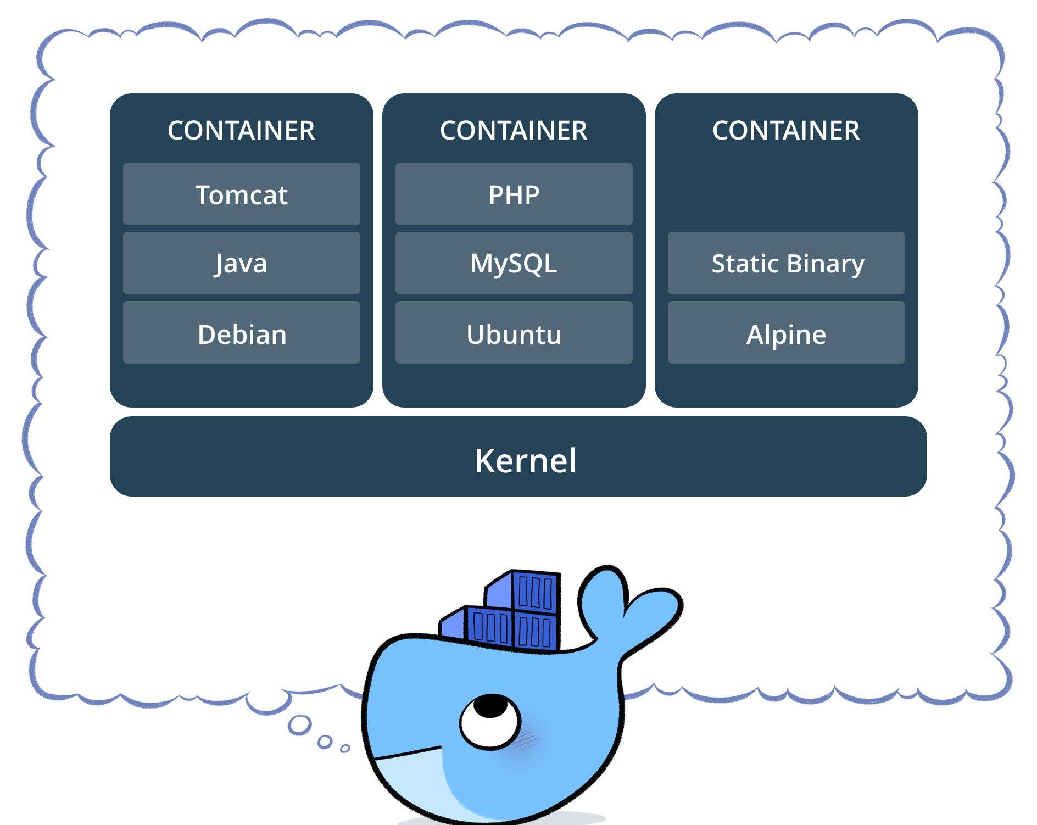
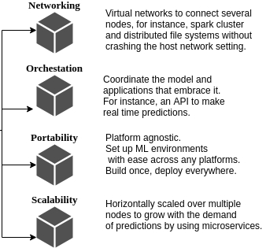
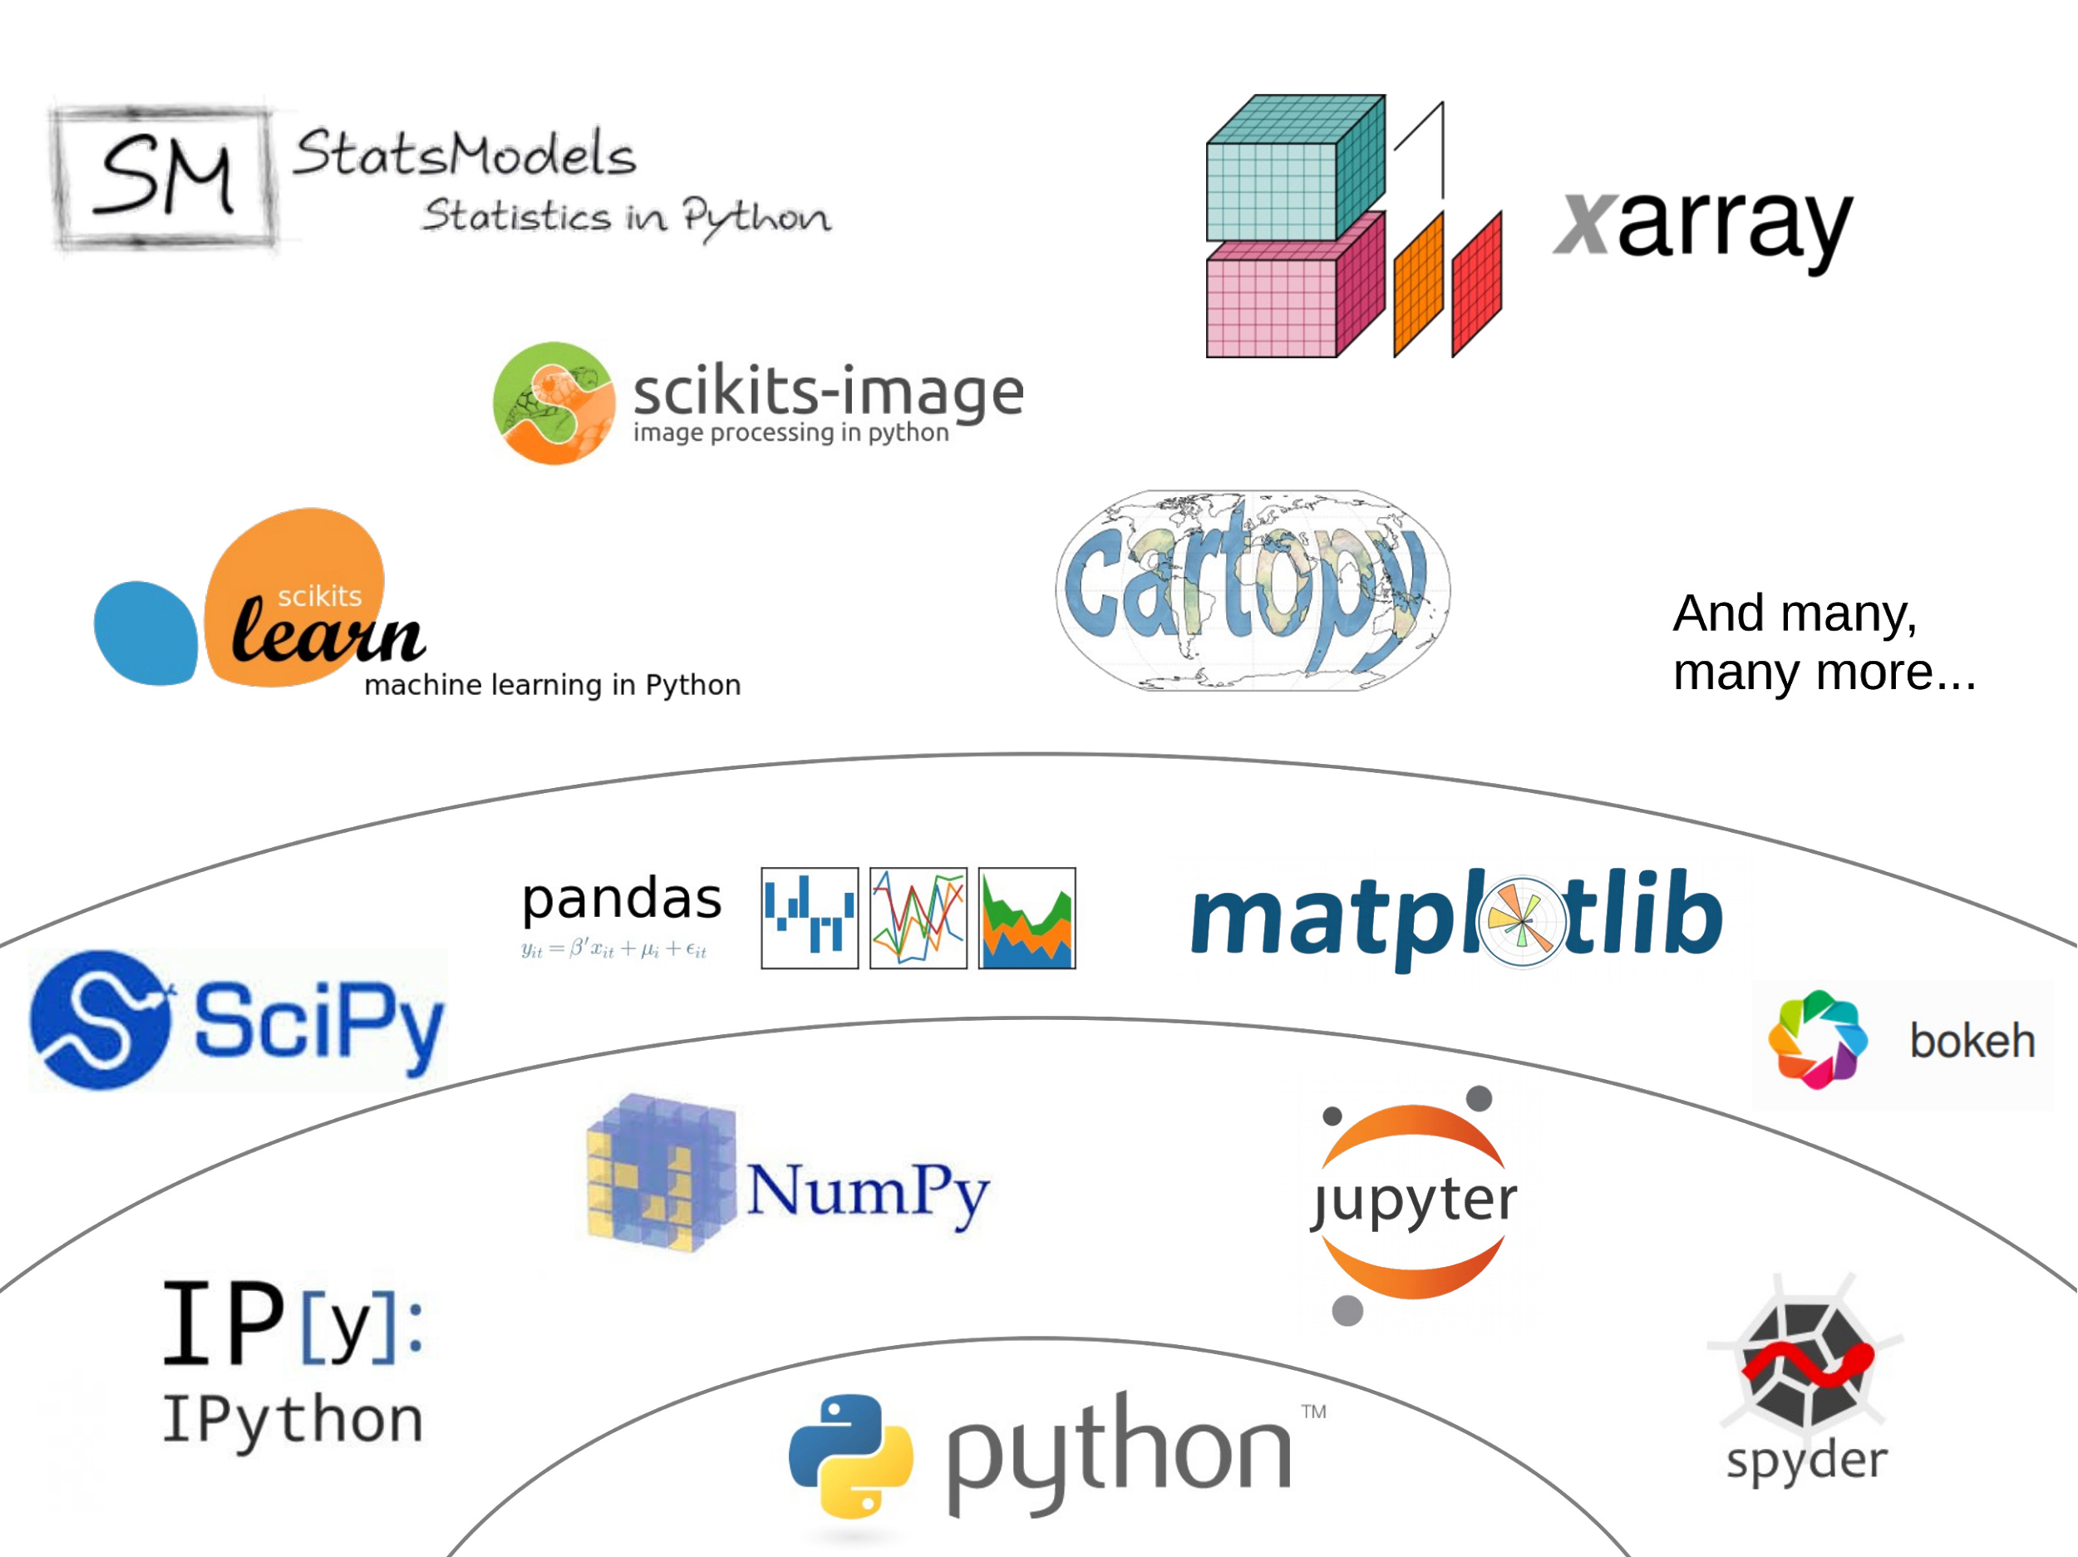

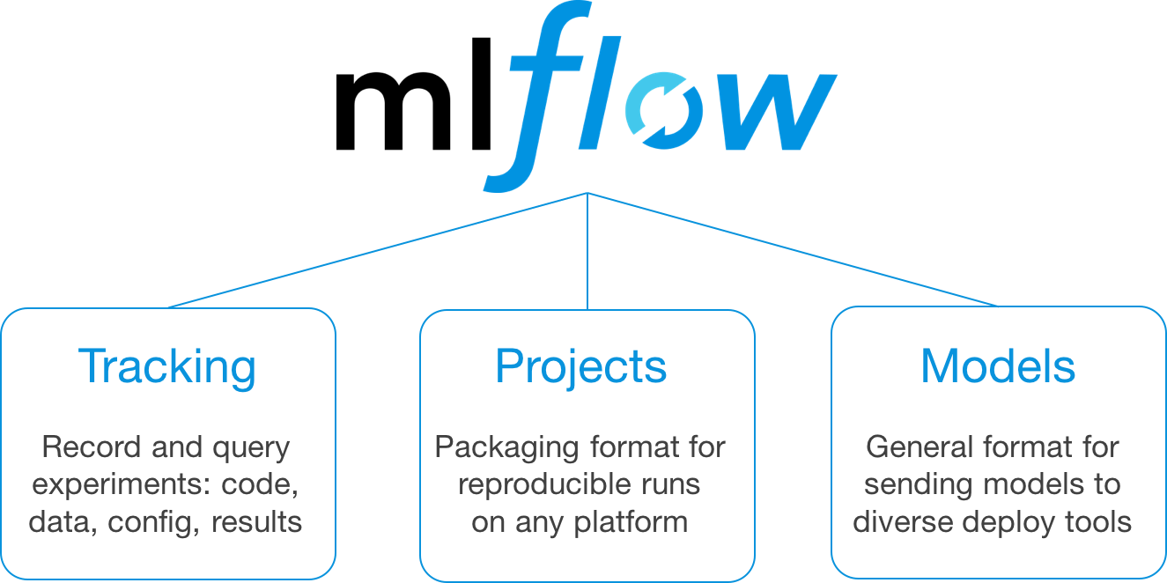
Applied Machine Learning: Recipes
Docker: Isolate environments, portability, scalability, affinity, etc.
Scanflow is a high-level library that is built on top of these tools to manage and supervise workflows efficiently.
Source: arquitectoit.com
Python: Fast prototyping
and expressiveness. Robust AI ecosystem.
MLflow: Track metrics, organize projects, model versioning and serialization, etc.
Source: mlflow.org
Source: leblancfg.com
Source: fjodor van veen - asimovinstitute.org

Slide 5
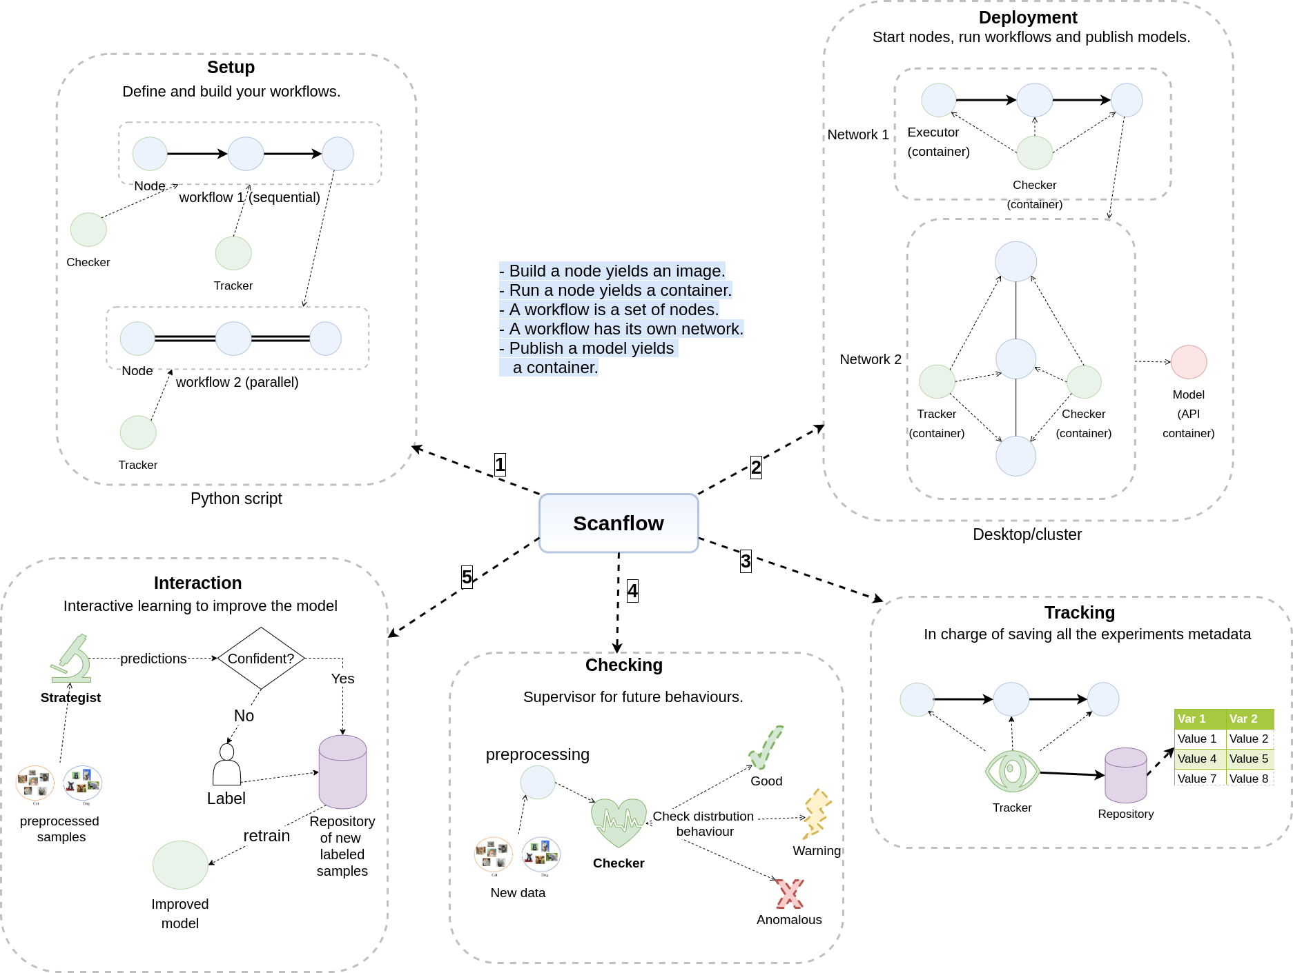
Scanflow: High-level overview

Slide 6
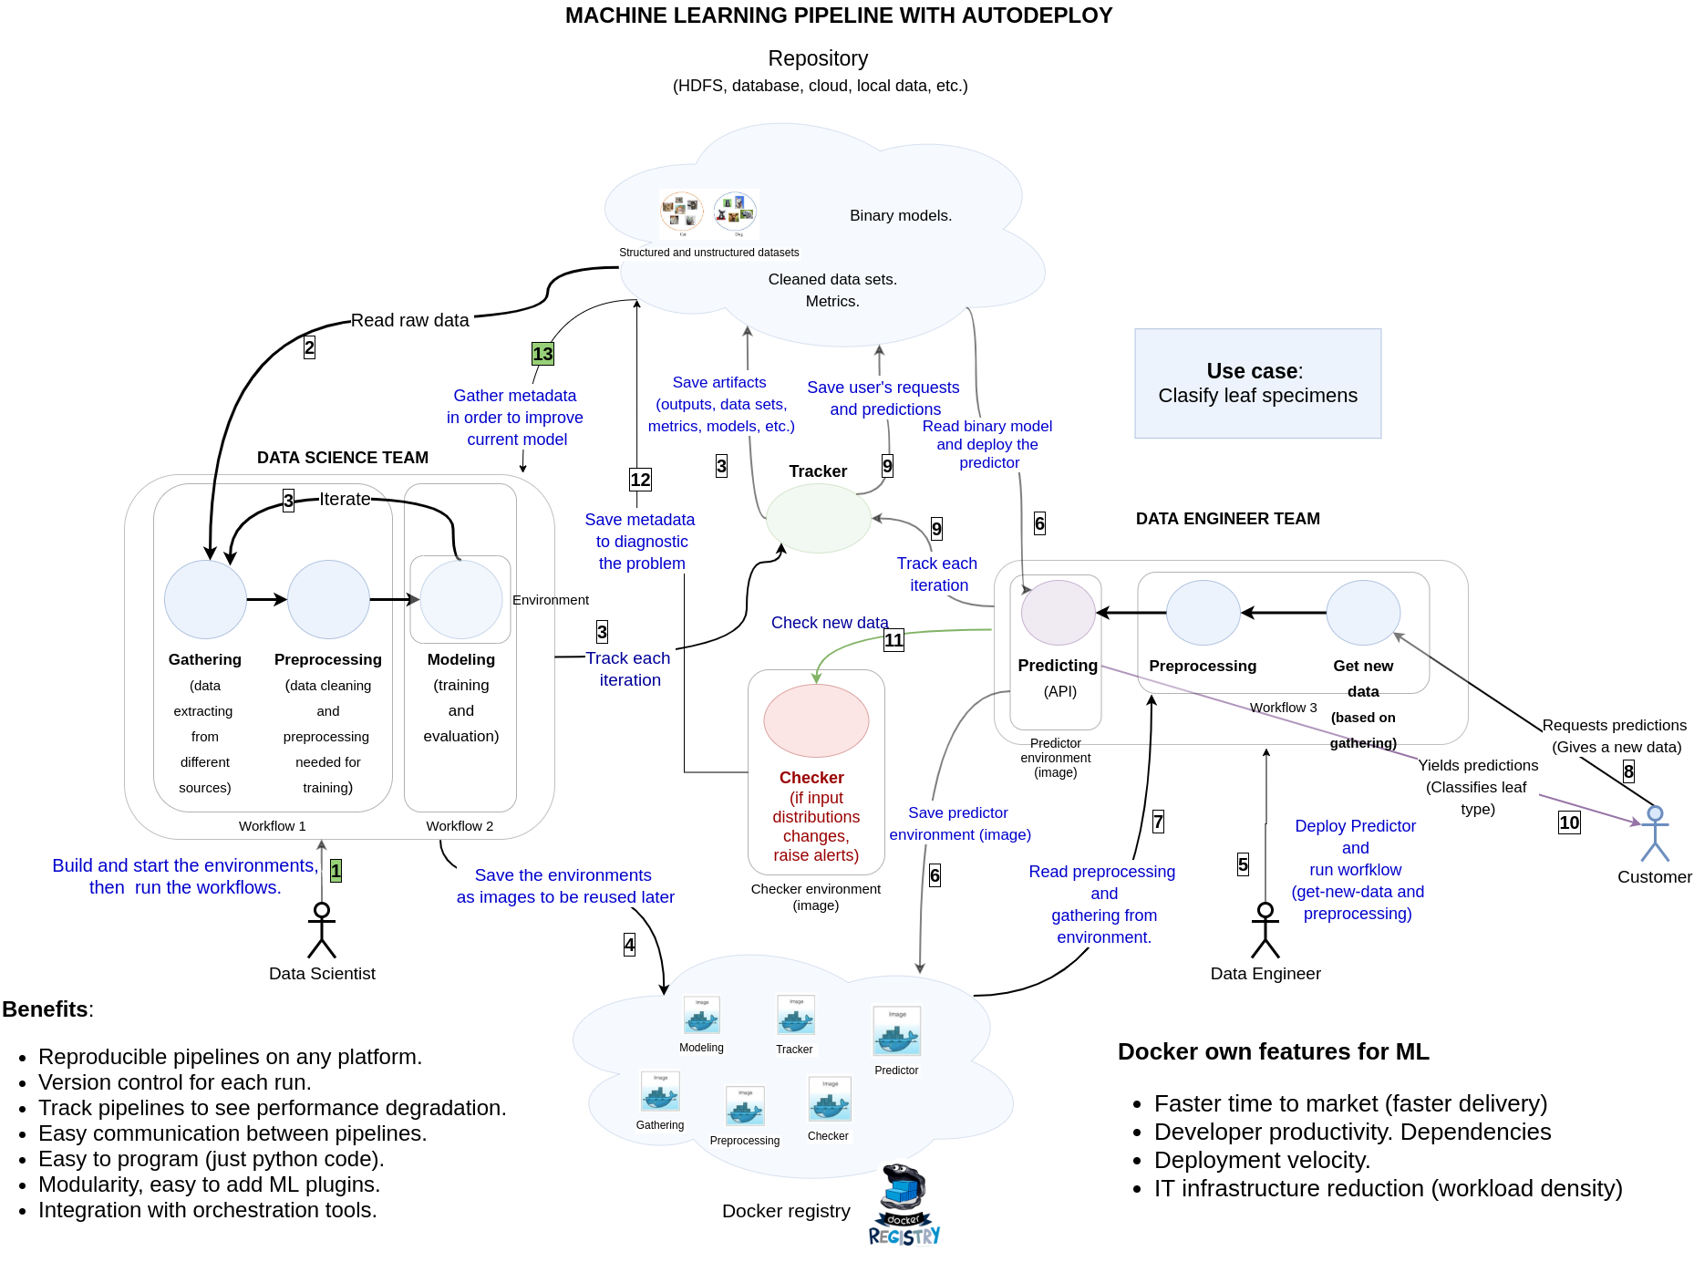
End-to-end use case

Slide 7
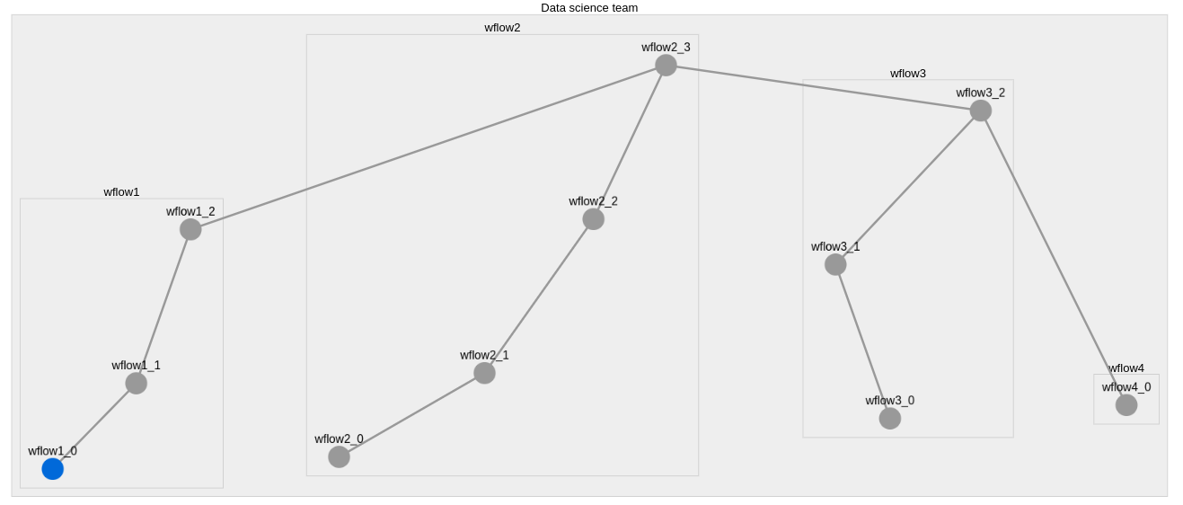
Setup and deployment
Design nested and parallel workflows: Each node is a computation function, e.g preprocessing or modeling. They can be run following the user ordering design. Besides, each node is a docker container (environment) inside a workflow (rectangle in the following picture). Finally, each workflow has its own checker (behaviour) or tracker (metadata).
Checker
Tracker

Slide 8
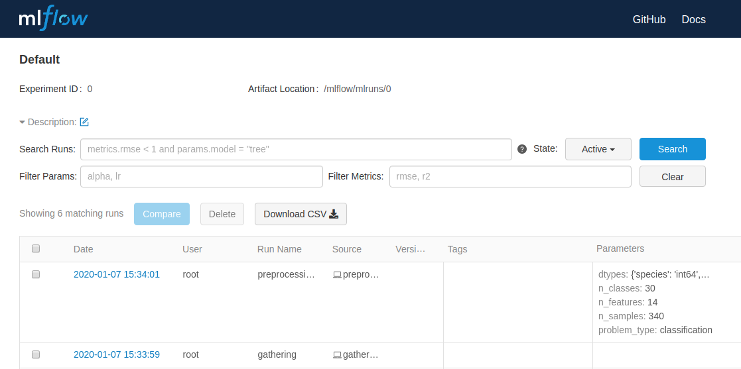
Tracking: Save any workflow metadata for future analysis
This module logs intermediate results belonging to a workflow such as, settings, metrics, statistics, scores, etc.

Slide 9
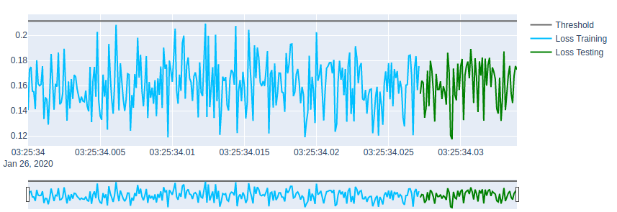
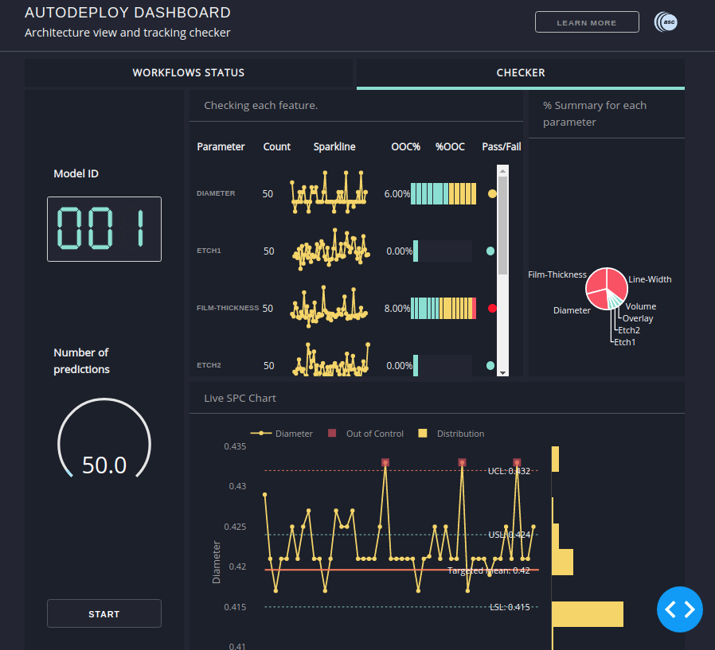
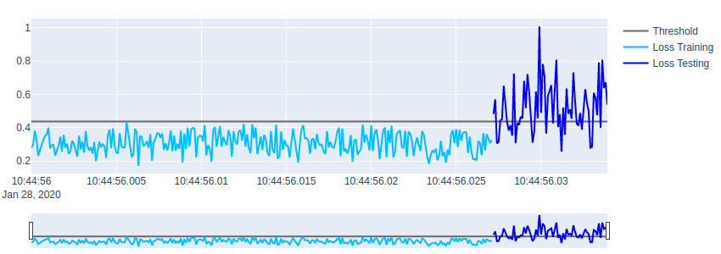
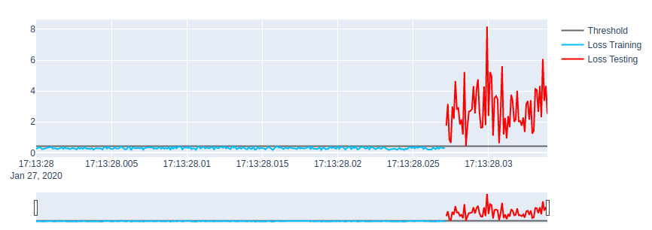
Checking: supervise workflow’s behaviour in production
Early drift distribution detector (built-in function)
Custom plugins can be added to check the behaviour of any workflow: for sanity, integrity, anomaly, interpretability, etc.
Any plugin is supposed to be run in real time

Slide 10
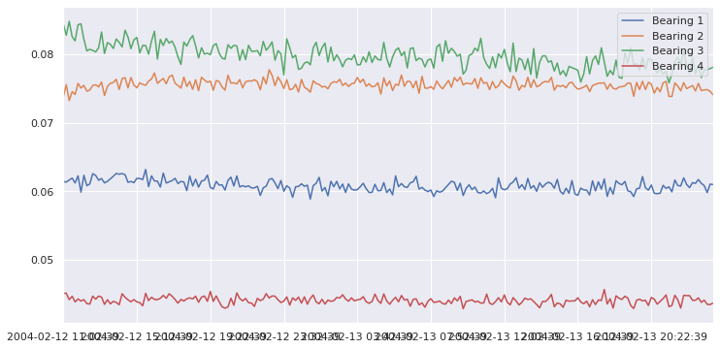
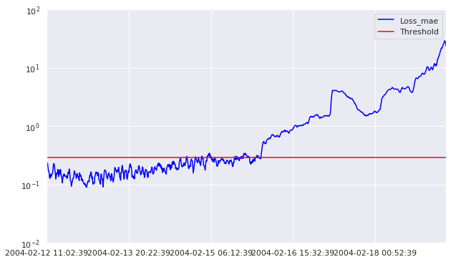
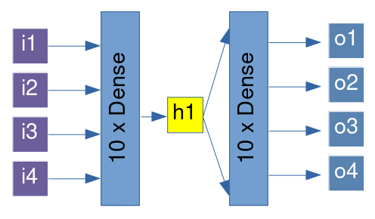
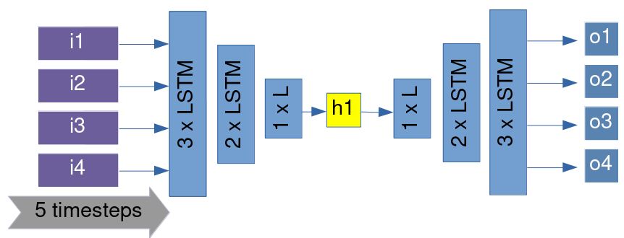
Early drift distribution detector: architecture
Reconstruction error is calculated to measure how different is a new distribution from the original one
Input
Output
Naive Autoencoder
LSTM Autoencoder

Slide 11
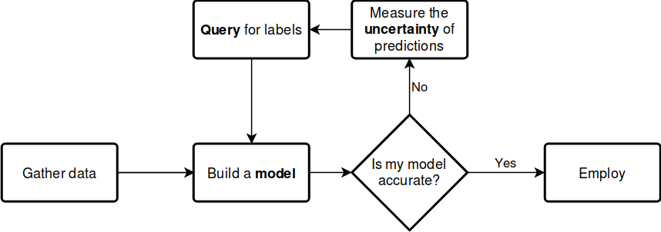
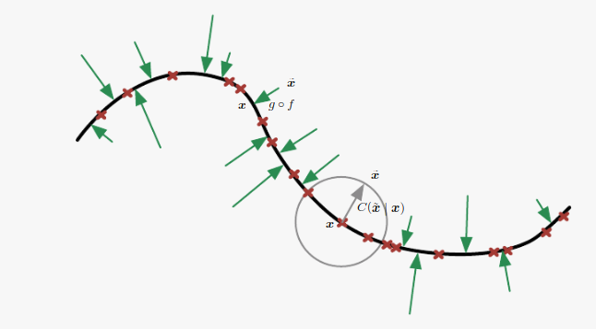
Interact: Interactive learning for improving the model
Source: modAL
Here we learn a latent space that can get the more useful features from the original distribution to the aim of measuring informativeness
Our objective is to find out the best strategy to measure uncertainty. It means, find the samples that are more informative to the model
Our first approach is to build a deep denoise autoencoder that can select the samples that have more entropy
Source: Deep learning book, autoencoders. Ian Goodfellow at el.

Slide 12
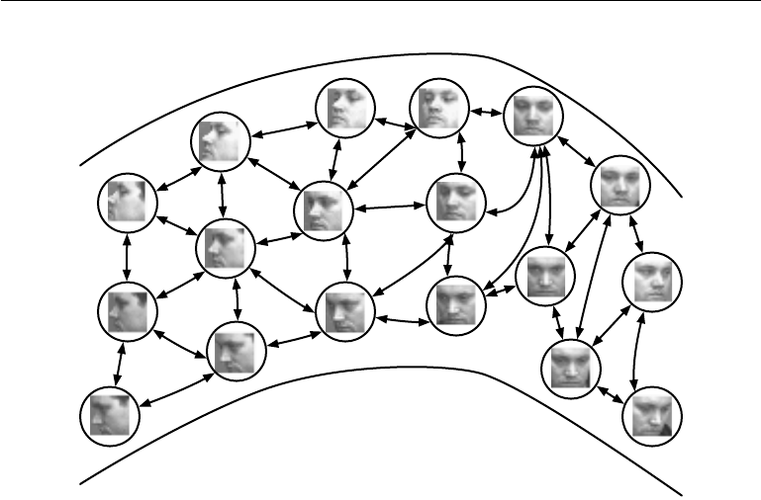
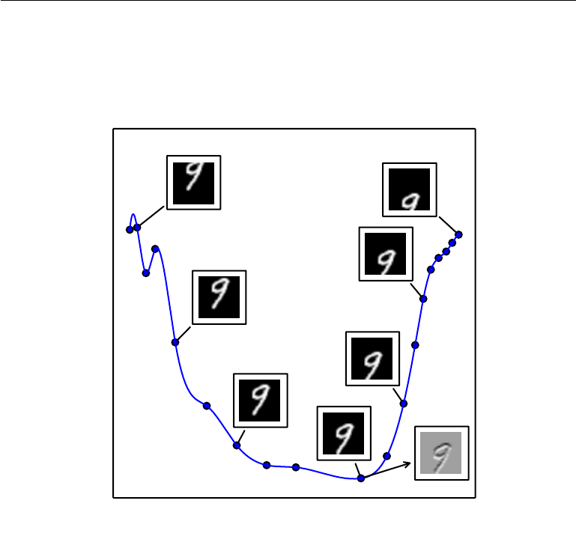
Interact: Interactive learning for improving the model
Having a good latent space means that we have learnt a low dimensional space that best represents the expected behaviour. E.g, in the picture, each face belongs to the same man, even if they have different representations (e.g, rotations). With this we can detect, in inference stage, those samples that are far from this space. Our hypothesis is that these points add more information to the current model.
Source: Deep learning book, autoencoders. Ian Goodfellow at el.

Slide 13
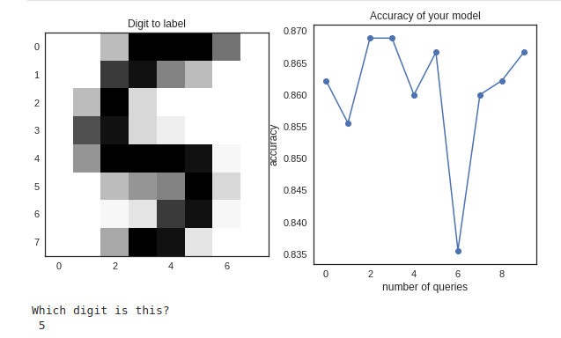
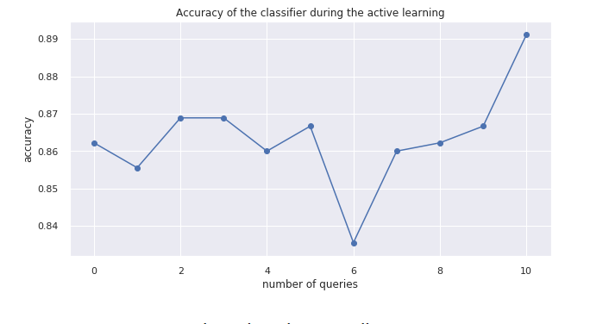
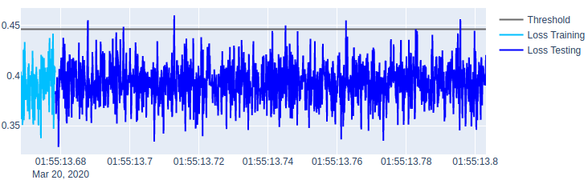
Interact: Use case I
Example using the MNIST dataset
Label just the set of samples that brings more information to the model
After labeling, the model has filled out gaps in the feature space, therefore, it’s improved.
The points above the threshold (gray line) are the chosen.

Slide 14

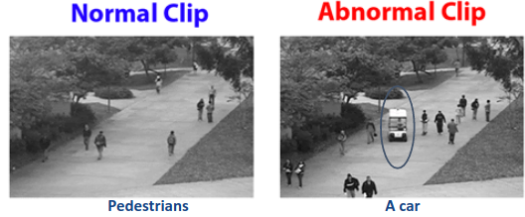
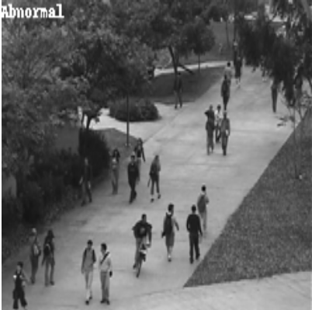
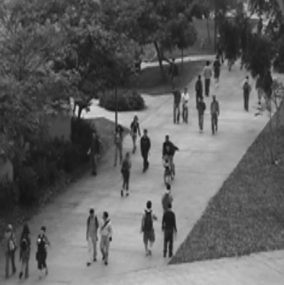
Interact: Use case II
Current model: A model built with
only pedestrian scenario as a input. Other scenarios will be anomalous.
Pedestrians
A car
A bike
Before labeling. A bike is detected as anomalous. False positive. Score: 75%
After labeling. A bike is detected now as normal. Score: 90%

Slide 15
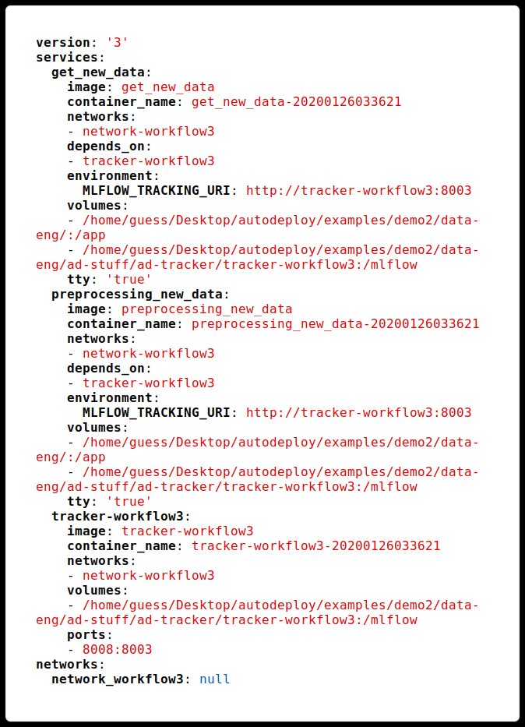
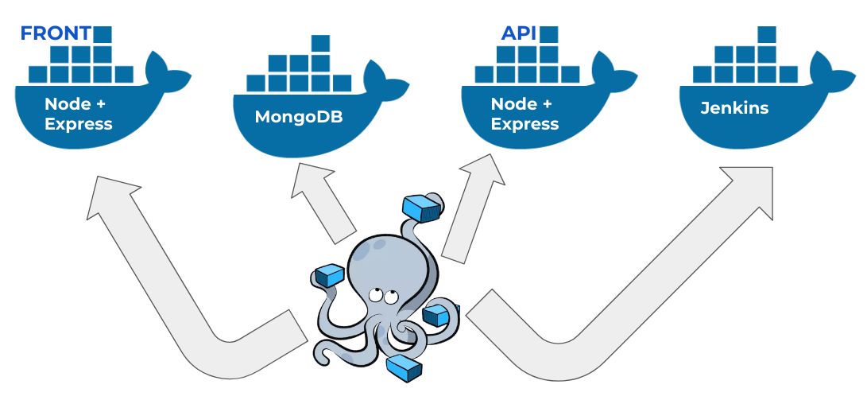
Deployment integration: Docker compose
docker-compose.yml
Docker compose behaviour
Source: medium.com
Once finished defining the workflows, they can be saved as a docker-compose file

Slide 16
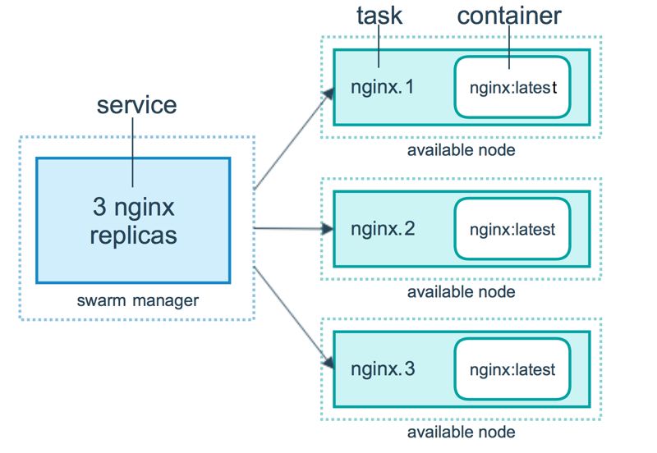
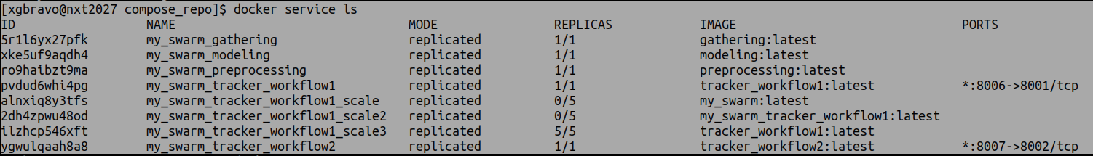
Deployment integration: Docker Swarm
Docker Swarm behaviour
Scanflow provides a docker-stack file to deploy a swarm cluster to schedule the workflows.
Source: filepicker.io
Docker Swarm console

Slide 17
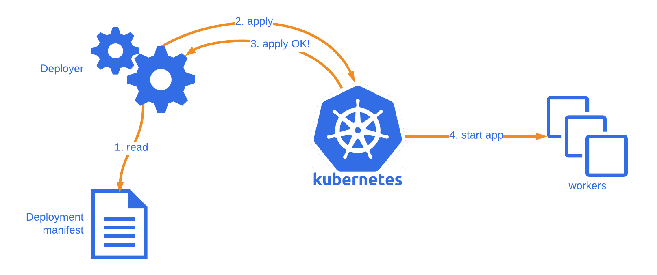
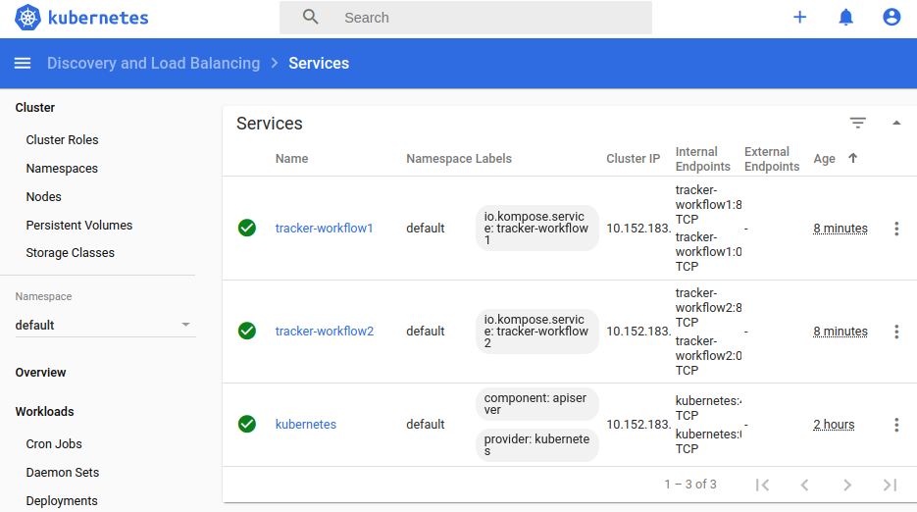
Deployment integration: Kubernetes
Scanflow provides a kube.config file to deploy a kubernetes cluster to schedule the workflows.
Source: medium.com
Kubernetes dashboard

Slide 18
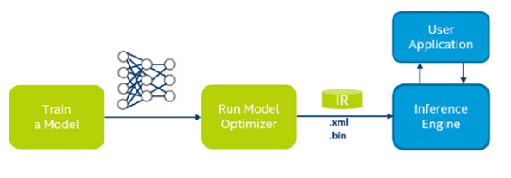
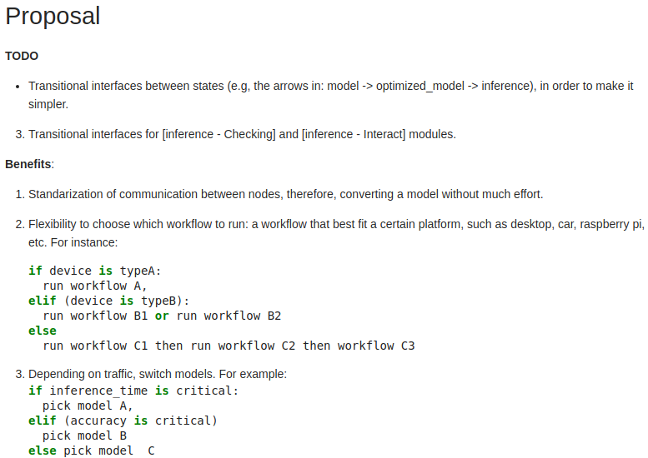
Deployment integration: Intel OpenVINO
Intel tries to accelerate the model inference by lowering numerical precision training and inference
-However, adapting current working nodes and workflows to these optimizer nodes is not direct.
- Our proposal is to develop interfaces that facilitate this integration.

Slide 19
Comparison ML workflow tools
 | MLflow | Scanflow | Kubeflow/Airflow
Usability | Medium | High | Low
Built-in scheduling | No | No | Yes
Dynamic execution | No | Yes | Yes
Experiment tracking | Yes | Yes | Yes
Model versioning | Yes | Yes | Yes
Model checking | No | Yes | No
Orchestration-agnostic | Yes | Yes | No
Most appropriate tools for:
- Pre-deployment (steps required for getting a model): MLflow, Scanflow.
- Deployment (put a model into production): MLflow, Scanflow, Kubeflow/Airflow.
- Post-Deployment (check the model's health): Scanflow.
- Ease of use: Scanflow > MLflow > Kubeflow/Airflow.
Scanflow’s main goals are usability, integration for deployment and real-time checking

Slide 20
Is it relevant?. AI predictions for 2020.
Creator of pytorch: … “ place more value on AI model performance beyond accuracy. “
Celeste Kidd, psychologist at the University of California, Berkeley: … “ increased awareness of the real-life implications of tech tools … “
Jeff Dean, Google AI chief: … “ he wants to see less of an emphasis on slight state-of-the-art advances in favor of creating more robust models. “
Anima, Anandkumar, NVIDIA: … “ self-supervision, and self-training methods of training models, which are the kinds of models that can improve through self-training with unlabeled data. “
Dario gil, IBM: …” focus on metrics beyond accuracy to consider the value of models deployed in production. Shifting the field toward building trusted systems instead of prioritizing accuracy above all else will be a central pillar to the continued adoption of AI. ”
Keywords: robust models, interpretable models, trusted models.
Source: https://venturebeat.com/2020/01/02/top-minds-in-machine-learning-predict-where-ai-is-going-in-2020/

Slide 21
Current status
Creation of nested workflows where each node can be an executor, tracker or checker. DONE
Isolation of each workflow using docker, it comprises auto-creation of networks, volumes, docker files, images, containers and registries. DONE
Tested integration with docker-compose.
Ongoing development on swarm and kubernetes integration.
Deploy ML models into services for prediction.
Tracking module for saving any metadata. DONE
Checking module (for now, drift distribution plugin) for post-deployment. DONE
Developing Interact module.

Slide 22
Future work
Interaction module: it will in charge of the interaction between the model and the human with the aim of make the former better. Human-in-the-loop intelligent systems.
Lightweight integration with additional third-party tools.
Enhance interface module for checking.
Dashboard for checking module.
Improve compatibility with docker-compose, swarm, kubernetes.
Test more use cases.
Start formalizing scanflow for writing a paper.
Start writing documentation.
Set up scanflow as a python package.
Improve drift distribution checker.
Add option for wipe out any metadata (tracking and checking).
Add a new plugin for integrity checking.
Add option to compress all the settings needed to transfer an application.
Add interface to write on databases.
Add option to plot nested workflows in jupyter notebooks.

